Slide 1
数字系统设计 第三次实验课
主要内容： lab4
卓若凡
2021.4.6

Slide 2
lab4
Implement the Electronic lock learnt in class with the following function diagram (see slides of lecture 5).
Draw the state diagram of the FSM in the above figure.
Write the behavior level Verilog module of the FSM.
Write a testbench to simulate the FSM by using the method in Lab 3.
Write the Verilog description of the whole design in the above figure and test it in your Basys3 board.
Synthesis the FSM by hand to draw the circuit of the FSM with only the D flipflops and AND/OR/NOT gate. Verify the circuit you synthesized and the circuit synthesized by Vivado.
From the synthesized circuit by your own, write the Verilog module of the FSM: For the next-state logic and the output logic, use “assign” statement to describe the combinational logic, and for the D flipflop, use “always” statement to describe it.
For the whole design, replace the FSM module designed in step 2) with that designed in step 6), and implement the whole design in your board.

Slide 3
功能介绍
输入input：
按钮：reset
按钮：按下一次输入一个0
按钮：按下一次输入一个1
输出output：
LED：亮起来表明已解锁
七段数码管：显示当前状态

Slide 4
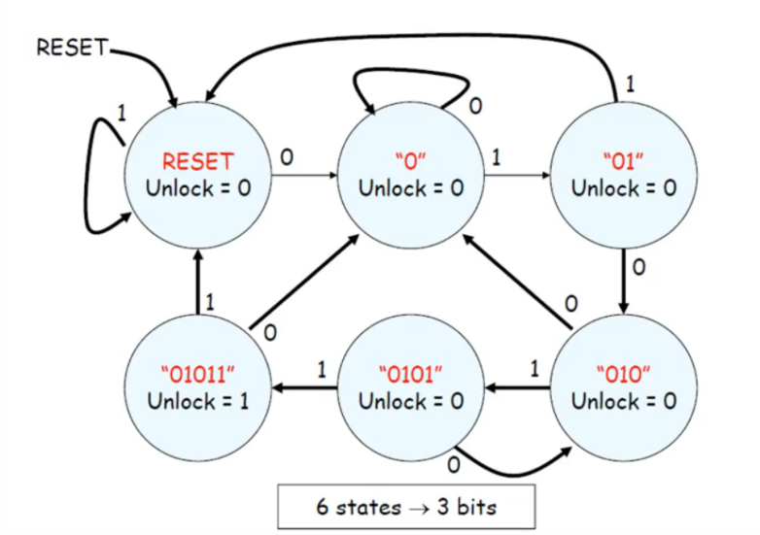
FSM

Slide 5
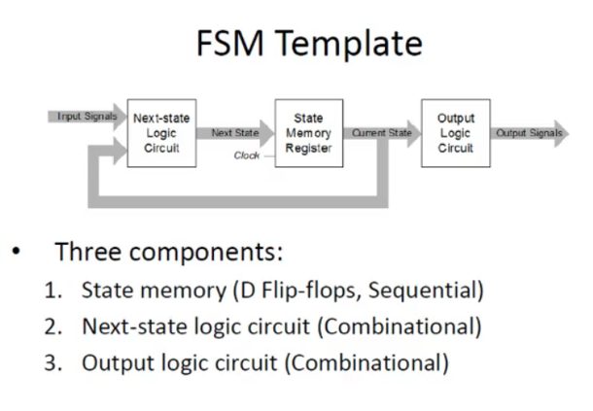

Slide 6
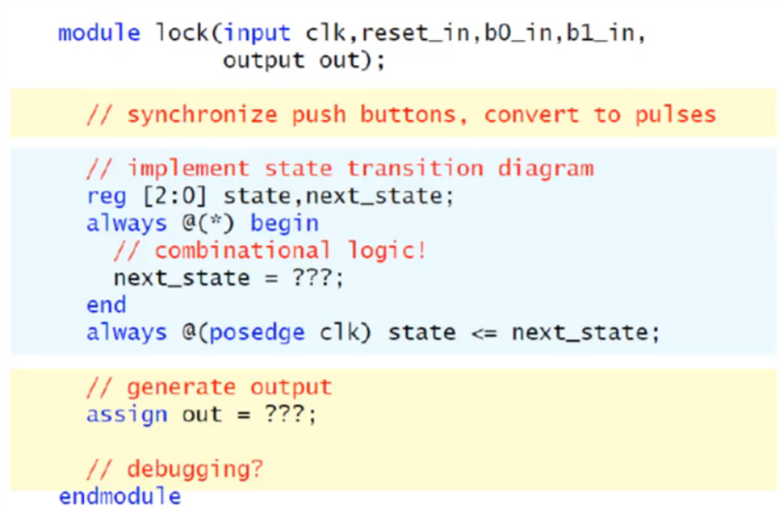
三段式状态机
次态逻辑
现态赋值
输出

Slide 7
module E_LOCK_FSM(
input clk,reset,b0,b1,
output out,
output [3:0] hex_display
);
//定义状态
parameter S_RESET = 0; parameter S_0 = 1;
parameter S_01 = 2; parameter S_010 = 3;
parameter S_0101 = 4; parameter S_01011 = 5;
reg [2:0] state, next_state;
//次态逻辑
always@(*) begin
if(reset) next_state = S_RESET;
else case (state)
S_RESET: next_state = b0 ? S_0 :b1 ? S_RESET:state;
S_0: next_state = b0 ? S_0 :b1 ? S_01 :state;
S_01: next_state = b0 ? S_010:b1 ? S_RESET:state;
S_010: next_state = b0 ? S_0 :b1 ? S_0101 :state;
S_0101: next_state = b0 ? S_010:b1 ? S_01011:state;
S_01011: next_state = b0 ? S_0 :b1 ? S_RESET:state;
default: next_state = S_RESET;
endcase
end
//现态赋值
always@(posedge clk) state<= next_state;
//输出
assign out = (state == S_01011);
assign hex_display = {1'b0,state};
endmodule

Slide 8
pre lab4 中button 和debounce代码的修改
删除与reset相关的代码
light的行为
if(old_button == 0 and button == 1) light <= ~light;
改为
if(old_button == 0 and button == 1) light <= 1;
else light <= 0;

Slide 9
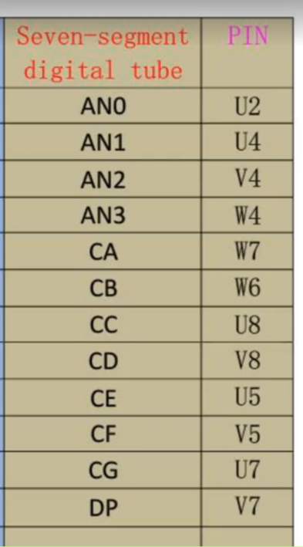
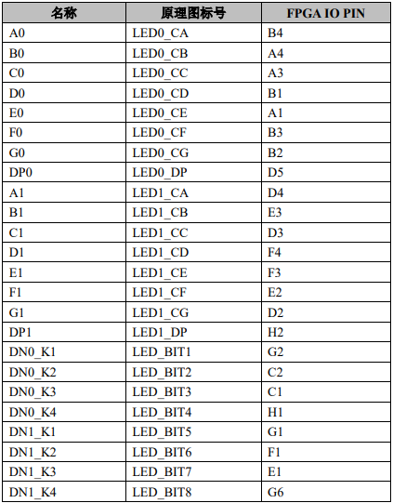
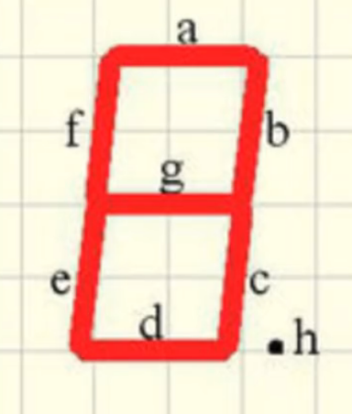
basys 3
ego 1

Slide 10
module segment(
input [3:0] hex_display,
output [11:0] seg
);
always@(hex_display)
begin
case(hex_display)
0: seg = 12'b
endcase
endmodule

Slide 11
top module
module E_LOCK(
input clk, reset_in, b0_in, b1_in,
output out,
output [11:0] seg
);
wire reset, b0, b1;
button b_reset(clk,reset_in,reset);
button b_0(clk,b0_in,b0);
button b_1(clk,b1_in,b1);
wire [3:0] hex_display;
E_LOCK_FSM FSM1(clk,reset,b0,b1,out,hex_display);
segment seg1(hex_display,seg);
endmodule

Slide 12
实验报告的内容：
1.行为级代码、仿真以及板子上的结果
2.手写的状态图、手写综合的过程以及最后的状态机电路
3.根据手写的状态机电路写成的电路级代码

